Slide 1
CS162 Operating Systems and Systems Programming Lecture 14 Caching and TLBs (Finished), Demand Paging
March 12th, 2020
Prof. John Kubiatowicz
http://cs162.eecs.Berkeley.edu

Slide 2
Recall: Fix for sparse address space: The two-level page table
Physical
Address:
Physical
Page #
Offset
10 bits
10 bits
12 bits
Virtual
Address:
Virtual
P1 index
Virtual
P2 index
Offset
4KB
PageTablePtr
4 bytes
Tree of Page Tables
“Magic” 10b-10b-12b pattern!
Tables fixed size (1024 entries)
On context-switch: save single PageTablePtr register (i.e. CR3)
Valid bits on Page Table Entries
Don’t need every 2nd-level table
Even when exist, 2nd-level tables can reside on disk if not in use
4 bytes

Slide 3
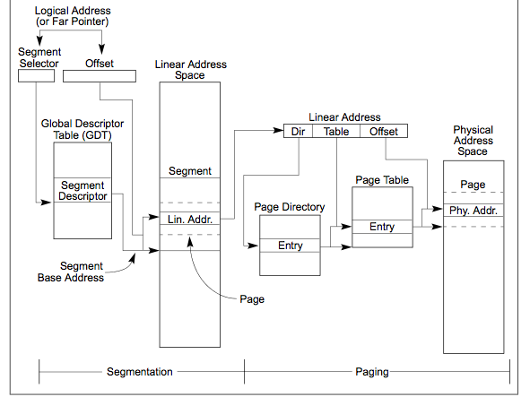
Recall: Making it real: X86 Memory model with segmentation (16/32-bit)
Segment Selector from instruction: mov eax, gs(0x0)
2-level page table in 10-10-12 bit address
Second level
called “table”
Combined address
Is 32-bit “linear”
Virtual address
First level
called “directory”

Slide 4
Recall: In Machine Structures (eg. 61C) …
Caching is the key to memory system performance
Main
Memory
(DRAM)
Processor
Access time = 100ns
Main
Memory
(DRAM)
Cache
(SRAM)
Processor
1 ns
100ns
Average Memory Access Time (AMAT)
= (Hit Rate x HitTime) + (Miss Rate x MissTime)
Where HitRate + MissRate = 1
HitRate = 90% => AMAT = (0.9 x 1) + (0.1 x 101)=11.1 ns
HitRate = 99% => AMAT = (0.99 x 1) + (0.01 x 101)=2.01 ns
MissTime_{L1} includes HitTime_{L1}+MissPenalty_{L1} ≡ HitTime_{L1} +AMAT_{L2}
Notes:
So, the role of a cache is to reduce the average memory access time. So, here we have a processor; if it directly needs to go to memory to access something, it takes 100ns.
Remember, processors are superfast, they compute in small cycles, and hence 100ns is a really long time for them.
If we add a second level cache, we can instead access the same data in 10ns, i.e.,10 times faster than directly going to memory.
To quantify the gain due to a cache, we can compute the average access time: and its simply the hit-rate (times we find it in the cache). …
So, we get an illusion that we can access the main memory at such a fast speed, due to caching.

Slide 5
Recall: The Memory Hierarchy
Managed in Hardware
Processor
Secondary Storage (Disk)
TLB
PT
L2 Cache
Registers
L1 Cache
Secondary Storage (SSD)
PT
PT
Main
Memory
(DRAM)
PT
PT
TLB
L3 Cache (shared)
L2 Cache
Registers
L1 Cache
Accessed in Hardware
Speed (ns):
0.3
1
3
10-30
100
100,000 (0.1 ms)
10,000,000
(10 ms)
Size (bytes):
100Bs
10kBs
100kBs
MBs
GBs
100GBs
TBs
Notes:
The design goal is to present the user with as much memory as is available in the cheapest technology (points to the disk).
While by taking advantage of the principle of locality, we like to provide the user an average access speed that is very close to the speed that is offered by the fastest technology.
(We will go over this slide in details in the next lecture on caches).
+1 = 16 min. (X:56)

Slide 6
Recall: How to make Address Translation Fast?
Cache results of recent translations !
Different from a traditional cache
Cache Page Table Entries using Virtual Page # as the key
Read <Phs_Addr X >
Physical
Memory
Read <V_Addr m>
Processor
(core)
pgm data
MMU
Cache(s)
Memory Bus
PTBR
page tables
V_Pg M₁ : <Phs_Frame #₁, V, … >
V_Pg M₂ : <Phs_Frame #₂, V, … >
V_Pg M₂ : <Phs_Frame #₂, V, … >
V_Pg M_{k} : <Phs_Frame #_{k}, V, … >

Slide 7
Translation Look-Aside Buffer
TLB is a cache of translations:
Record recent Virtual Page # to Physical Frame # translation
If present, get the physical address from TLB without reading any of the page tables !!!
Even if the translation involved multiple levels
Caches the end-to-end result
Was invented by Sir Maurice Wilkes – prior to caches
People realized “if it’s good for page tables, why not the rest of the data in memory?”
On a TLB miss, the page tables may be cached, so only go to memory when both miss
Ultimately invokes page table walk

Slide 8
Caching Applied to Address Translation
Virtual
Address
TLB
Physical
Memory
CPU
Physical
Address
Cached?
Yes
No
Save
Result
Translate
(MMU)
Data Read or Write
(untranslated)
Question is one of page locality: does it exist?
Instruction accesses spend a lot of time on the same page (since accesses sequential)
Stack accesses have definite locality of reference
Data accesses have less page locality, but still some…
Can we have a TLB hierarchy?
Sure: multiple levels at different sizes/speeds

Slide 9
What kind of Cache for TLB?
Set Size (k) - Associativity
# of Sets (N)
. . .
. . .
tag
data
line size (L)
Remember all those cache design parameters and trade-offs?
Amount of Data = N * L * K
Tag is portion of address that identifies line (w/o line offset)
Write Policy (write-thru, write-back), Eviction Policy (LRU, …)

Slide 10
How might organization of TLB differ from that of a conventional instruction or data cache?
Let’s do some review …

Slide 11
A Summary on Sources of Cache Misses
Compulsory (cold start or process migration, first reference): first access to a block
“Cold” fact of life: not a whole lot you can do about it
Note: If you are going to run “billions” of instruction, Compulsory Misses are insignificant
Capacity:
Cache cannot contain all blocks access by the program
Solution: increase cache size
Conflict (collision):
Multiple memory locations mapped to the same cache location
Solution 1: increase cache size
Solution 2: increase associativity
Coherence (Invalidation): other process (e.g., I/O) updates memory
Notes:
(Capacity miss) That is the cache misses are due to the fact that the cache is simply not large enough to contain all the blocks that are accessed by the program.
The solution to reduce the Capacity miss rate is simple: increase the cache size.
Here is a summary of other types of cache miss we talked about.
First is the Compulsory misses. These are the misses that we cannot avoid. They are caused when we first start the program.
Then we talked about the conflict misses. They are the misses that caused by multiple memory locations being mapped to the same cache location.
There are two solutions to reduce conflict misses. The first one is, once again, increase the cache size. The second one is to increase the associativity.
For example, say using a 2-way set associative cache instead of directed mapped cache.
But keep in mind that cache miss rate is only one part of the equation. You also have to worry about cache access time and miss penalty. Do NOT optimize miss rate alone.
Finally, there is another source of cache miss we will not cover today. Those are referred to as invalidation misses caused by another process, such as IO , update the main memory so you have to flush the cache to avoid inconsistency between memory and cache.
+2 = 43 min. (Y:23)

Slide 12
How is a Block found in a Cache?
Block Address
Block
offset
Tag
Index
Set Select
Data Select
Block is minimum quantum of caching
Data select field used to select data (byte) within block
Many caching applications don’t have data select field
Index Used to Lookup Candidates in Cache
Index identifies the set
Tag used to identify actual copy
If no candidates match, then declare cache miss

Slide 13
Review: Direct Mapped Cache
Direct Mapped 2^{N} byte cache:
The uppermost (32 - N) bits are always the Cache Tag
The lowest M bits are the Byte Select (Block Size = 2^{M})
Example: 1 KB Direct Mapped Cache with 32 B Blocks
Index chooses potential block
Tag checked to verify block
Byte select chooses byte within block
31
9
4
0
Cache Tag
Cache Index
Byte Select
Ex: 0x50
Ex: 0x01
Ex: 0x00
Valid Bit
Cache Tag
Cache Data
Byte 31
:
Byte 1
Byte 0
0
0x50
Byte 63
:
Byte 33
Byte 32
1
2
3
:
:
:
Byte 1023
:
Byte 992
31
Notes:
Let’s use a specific example with realistic numbers: assume we have a 1 KB direct mapped cache with block size equals to 32 bytes.
In other words, each block associated with the cache tag will have 32 bytes in it (Row 1).
With Block Size equals to 32 bytes, the 5 least significant bits of the address will be used as byte select within the cache block.
Since the cache size is 1K byte, the upper 32 minus 10 bits, or 22 bits of the address will be stored as cache tag.
The rest of the address bits in the middle, that is bit 5 through 9, will be used as Cache Index to select the proper cache entry.
+2 = 30 min. (Y:10)

Slide 14
Review: Set Associative Cache
N-way set associative: N entries per Cache Index
N direct mapped caches operates in parallel
Example: Two-way set associative cache
Cache Index selects a “set” from the cache
Two tags in the set are compared to input in parallel
Data is selected based on the tag result
31
8
4
0
Cache Tag
Cache Index
Byte Select
Valid
Cache Tag
Cache Data
Cache Data
Cache Tag
Valid
Cache Block 0
Cache Block 0
:
:
:
:
:
:
Compare
Sel1
1
Mux
0
Sel0
Compare
OR
Hit
Cache Block
Notes:
This is called a 2-way set associative cache because there are two cache entries for each cache index. Essentially, you have two direct mapped cache works in parallel.
This is how it works: the cache index selects a set from the cache. The two tags in the set are compared in parallel with the upper bits of the memory address.
If neither tag matches the incoming address tag, we have a cache miss.
Otherwise, we have a cache hit and we will select the data on the side where the tag matches occur.
This is simple enough. What is its disadvantages?
+1 = 36 min. (Y:16)

Slide 15
Review: Fully Associative Cache
Fully Associative: Every block can hold any line
Address does not include a cache index
Compare Cache Tags of all Cache Entries in Parallel
Example: Block Size=32B blocks
We need N 27-bit comparators
Still have byte select to choose from within block
31
4
0
Cache Tag (27 bits long)
Byte Select
Ex: 0x01
Cache Tag
Valid Bit
Cache Data
=
Byte 31
:
Byte 1
Byte 0
=
Byte 63
:
Byte 33
Byte 32
=
=
:
:
:
=
Notes:
While the direct mapped cache is on the simple end of the cache design spectrum, the fully associative cache is on the most complex end.
It is the N-way set associative cache carried to the extreme where N in this case is set to the number of cache entries in the cache.
In other words, we don’t even bother to use any address bits as the cache index.
We just store all the upper bits of the address (except Byte select) that is associated with the cache block as the cache tag and have one comparator for every entry.
The address is sent to all entries at once and compared in parallel and only the one that matches are sent to the output. This is called an associative lookup.
Needless to say, it is very hardware intensive. Usually, fully associative cache is limited to 64 or less entries.
Since we are not doing any mapping with the cache index, we will never push any other item out of the cache because multiple memory locations map to the same cache location.
Therefore, by definition, conflict miss is zero for a fully associative cache. This, however, does not mean the overall miss rate will be zero.
Assume we have 64 entries here. The first 64 items we accessed can fit in.
But when we try to bring in the 65th item, we will need to throw one of them out to make room for the new item. This bring us to the third type of cache misses: Capacity Miss.
+3 = 41 min. (Y:21)

Slide 16

Administrivia (1/2)
Saturday (3/14) is π Day!!!
40 digits are sufficient to calculate circumference of visible universe to atomic dimensions: See: https://www.jpl.nasa.gov/edu/news/2016/3/16/how-many-decimals-of-pi-do-we-really-need/
Here are 40 decimal places: 3.1415926535897932384626433832795028841971
Best formula for PI is from Ramanujan:
$\frac{1}{π}=\frac{2\sqrt{2}}{9801}\sum_{k=0}^{∞}{\frac{\left(4k\right)!(1103+26390k)}{{(k!)}^{4}{396}^{4k}}}$
Google announced last year (3/14/19) that Emma Haruka Iwao calculated pi to 31,415,926,535,897 digits (new record…)

Slide 17
Administrivia (2/2)
Please remember to fill out your Project 1 Peer evaluations!
It is very important that you fill these out!
It is as important as getting to know your TA.
The project grades are a zero-sum game; if you do not contribute to the project, your points might be distributed to those who do!
Project 2 Design Docs due Yesterday
(Virtual) Design Reviews are still MANDATORY
They are an essential Oral Exam: you discuss design with your TA
Everyone must be present on the Zoom call (and be able to enable cameras): Remember that your TA is evaluating your participation as part of the design process!
Midterm 2: Still Scheduled for 4/02
Will likely be virtual, we don’t know yet
Ok, this is a few weeks and after Spring Break
Not sure what is going to happen yet; Study for it!
Material is up to and including some material from lecture 18

Slide 18
Where does a Block Get Placed in a Cache?
Example: Block 12 placed in 8 block cache
32-Block Address Space:
Block
no.
1 1 1 1 1 1 1 1 1 1 2 2 2 2 2 2 2 2 2 2 3 3
0 1 2 3 4 5 6 7 8 9 0 1 2 3 4 5 6 7 8 9 0 1 2 3 4 5 6 7 8 9 0 1
Direct mapped:
block 12 can go only into block 4 (12 mod 8)
Set associative:
block 12 can go anywhere in set 0 (12 mod 4)
Fully associative:
block 12 can go anywhere
Block
no.
0 1 2 3 4 5 6 7
Block
no.
0 1 2 3 4 5 6 7
Block
no.
0 1 2 3 4 5 6 7
Set
0
Set
1
Set
2
Set
3

Slide 19
Which block should be replaced on a miss?
Easy for Direct Mapped: Only one possibility
Set Associative or Fully Associative:
Random
LRU (Least Recently Used)
Miss rates for a workload:
2-way 4-way 8-way Size LRU Random LRU Random LRU Random
16 KB 5.2% 5.7% 4.7% 5.3% 4.4% 5.0%
64 KB 1.9% 2.0% 1.5% 1.7% 1.4% 1.5%
256 KB 1.15% 1.17% 1.13% 1.13% 1.12% 1.12%

Slide 20
Review: What happens on a write?
Write through: The information is written to both the block in the cache and to the block in the lower-level memory
Write back: The information is written only to the block in the cache
Modified cache block is written to main memory only when it is replaced
Question is block clean or dirty?
Pros and Cons of each?
WT:
PRO: read misses cannot result in writes
CON: Processor held up on writes unless writes buffered
WB:
PRO: repeated writes not sent to DRAM processor not held up on writes
CON: More complex Read miss may require writeback of dirty data

Slide 21
Impact of caches on Operating Systems
Dealing with cache effects
Maintaining the correctness of various caches
E.g., TLB consistency:
With PT across context switches ?
Across updates to the PT ?
Process scheduling
Which and how many processes are active ? Priorities ?
Large memory footprints versus small ones ?
Shared pages mapped into VAS of multiple processes ?
Impact of thread scheduling on cache performance
Rapid interleaving of threads (small quantum) may degrade cache performance
Increase average memory access time (AMAT) !!!
Designing operating system data structures for cache performance

Slide 22
What TLB Organization Makes Sense?
CPU
TLB
Cache
Memory
Needs to be really fast
Critical path of memory access
In simplest view: before the cache
Thus, this adds to access time (reducing cache speed)
Seems to argue for Direct Mapped or Low Associativity
However, needs to have very few conflicts!
With TLB, the Miss Time extremely high! (PT traversal)
Cost of Conflict (Miss Time) is high
Hit Time – dictated by clock cycle
Thrashing: continuous conflicts between accesses
What if use low order bits of page as index into TLB?
First page of code, data, stack may map to same entry
Need 3-way associativity at least?
What if use high order bits as index?
TLB mostly unused for small programs

Slide 23
TLB organization: include protection
How big does TLB actually have to be?
Usually small: 128-512 entries (larger now)
Not very big, can support higher associativity
Small TLBs usually organized as fully-associative cache
Lookup is by Virtual Address
Returns Physical Address + other info
What happens when fully-associative is too slow?
Put a small (4-16 entry) direct-mapped cache in front
Called a “TLB Slice”
Example for MIPS R3000:
Virtual Address Physical Address Dirty Ref Valid Access ASID
0xFA00 0x0003 Y N Y R/W 34 0x0040 0x0010 N Y Y R 0 0x0041 0x0011 N Y Y R 0

Slide 24
Example: R3000 pipeline includes TLB “stages”
MIPS R3000 Pipeline
Inst Fetch
Dcd/ Reg
ALU / E.A
Memory
Write Reg
TLB I-Cache RF Operation WB
E.A. TLB D-Cache
TLB
64 entry, on-chip, fully associative, software TLB fault handler
Virtual Address Space
ASID
V. Page Number
Offset
6
20
12
0xx User segment (caching based on PT/TLB entry)
100 Kernel physical space, cached
101 Kernel physical space, uncached
11x Kernel virtual space
Allows context switching among
64 user processes without TLB flush

Slide 25
Reducing translation time further
CPU
TLB
Cache
Memory
As described, TLB lookup is in serial with cache lookup:
Machines with TLBs go one step further: they overlap TLB lookup with cache access.
Works because offset available early
10
Virtual Address
V page no.
offset
TLB Lookup
V
Access
Rights
PA
P page no.
offset
Physical Address
10

Slide 26
Overlapping TLB & Cache Access (1/2)
Main idea:
Offset in virtual address exactly covers the “cache index” and “byte select”
Thus can select the cached byte(s) in parallel to perform address translation
virtual address
Virtual Page #
Offset
physical address
tag / page #
index
byte

Slide 27
Overlapping TLB & Cache Access
Here is how this might work with a 4K, direct-mapped cache:
This gets much more interesting if you want a larger cache
Increase page size (obvious, but not entirely desirable)
Increase associativity of cache (thereby decreasing index)
Start looking up in multiple chunks of cache, pick when TLB lookup is finished.
TLB
assoc
lookup
4K Cache
32
index
1 K
20
10
2
4 bytes
virtual page #
disp
00
Hit/
Miss
page #
=
Tag
Data
Hit/
Miss

Slide 28
Example TLB Sizes: Pentium-M TLBs (2003)
Four different TLBs
Instruction TLB for 4K pages
128 entries, 4-way set associative
Instruction TLB for large pages
2 entries, fully associative
Data TLB for 4K pages
128 entries, 4-way set associative
Data TLB for large pages
8 entries, 4-way set associative
All TLBs use LRU replacement policy
Why different TLBs for instruction, data, and page sizes?

Slide 29
Intel Nahelem (2008)
L1 DTLB
64 entries for 4 K pages and
32 entries for 2/4 M pages,
L1 ITLB
128 entries for 4 K pages using 4-way associativity and
14 fully associative entries for 2/4 MiB pages
unified 512-entry L2 TLB for 4 KiB pages, 4-way associative.

Slide 30
Current Intel x86 (Skylake, Cascade Lake)

Slide 31
Current Example: Memory Hierarchy
Caches (all 64 B line size)
L1 I-Cache: 32 KiB/core, 8-way set assoc.
L1 D Cache: 32 KiB/core, 8-way set assoc., 4-5 cycles load-to-use, Write-back policy
L2 Cache: 1 MiB/core, 16-way set assoc., Inclusive, Write-back policy, 14 cycles latency
L3 Cache: 1.375 MiB/core, 11-way set assoc., shared across cores, Non-inclusive victim cache, Write-back policy, 50-70 cycles latency
TLB
L1 ITLB, 128 entries; 8-way set assoc. for 4 KB pages
8 entries per thread; fully associative, for 2 MiB / 4 MiB page
L1 DTLB 64 entries; 4-way set associative for 4 KB pages
32 entries; 4-way set associative, 2 MiB / 4 MiB page translations:
4 entries; 4-way associative, 1G page translations:
L2 STLB: 1536 entries; 12-way set assoc. 4 KiB + 2 MiB pages
16 entries; 4-way set associative, 1 GiB page translations:

Slide 32
What happens to TLB on Context Switch?
Need to do something, since TLBs map virtual addresses to physical addresses
Address Space just changed, so TLB entries no longer valid!
Options?
Invalidate TLB: simple but might be expensive
What if switching frequently between processes?
Include ProcessID in TLB
This is an architectural solution: needs hardware
What if translation tables change?
For example, to move page from memory to disk or vice versa…
Must invalidate TLB entry!
Otherwise, might think that page is still in memory!
Called “TLB Consistency”

Slide 33
Putting Everything Together: Address Translation
Physical
Memory:
Virtual Address:
Virtual
P1 index
Virtual
P2 index
Offset
PageTablePtr
Physical Address:
Physical
Page #
Offset
Page Table
(1st level)
Page Table
(2nd level)

Slide 34
Putting Everything Together: TLB
Physical
Memory:
Virtual Address:
Virtual
P1 index
Virtual
P2 index
Offset
PageTablePtr
Physical Address:
Physical
Page #
Offset
Page Table
(1st level)
Page Table
(2nd level)
TLB:
…

Slide 35
Putting Everything Together: Cache
Physical
Memory:
Virtual Address:
Virtual
P1 index
Virtual
P2 index
Offset
PageTablePtr
Physical Address:
Physical
Page #
Offset
Page Table
(1st level)
tag
index
byte
cache:
Page Table
(2nd level)
tag:
block:
TLB:
…
…

Slide 36
Recall: Two Critical Issues in Address Translation
How to translate addresses fast enough?
Every instruction fetch
Plus every load / store
EVERY MEMORY REFERENCE !
More than one translation for EVERY instruction
Next: What to do if the translation fails?
Page fault! This is a synchronous exception!

Slide 37
Recall: User→Kernel (Exceptions: Traps & Interrupts)
A system call instruction causes a synchronous exception (or “trap”)
In fact, often called a software “trap” instruction
Other sources of Synchronous Exceptions (“Trap”):
Divide by zero, Illegal instruction, Bus error (bad address, e.g. unaligned access)
Segmentation Fault (address out of range)
Page Fault (for illusion of infinite-sized memory)
Interrupts are Asynchronous Exceptions:
Examples: timer, disk ready, network, etc….
Interrupts can be disabled, traps cannot!
On system call, exception, or interrupt:
Hardware enters kernel mode with interrupts disabled
Saves PC, then jumps to appropriate handler in kernel
Some processors (e.g. x86) also save registers, changes stack
Handler does any required state preservation not done by CPU:
Might save registers, other CPU state, and switches to kernel stack

Slide 38
Precise Exceptions
Precise ⇒ state of the machine is preserved as if program executed up to the offending instruction
All previous instructions completed
Offending instruction and all following instructions act as if they have not even started
Same system code will work on different implementations
Difficult in the presence of pipelining, out-of-order execution, ...
Imprecise ⇒ system software has to figure out what is where and put it all back together
Performance goals may lead designers to forsake precise interrupts
system software developers, user, markets etc. usually wish they had not done this
Modern techniques for out-of-order execution and branch prediction help implement precise interrupts
Architectural support for OS is hard
Original M68000 had paging, but didn’t save fault address properly
Original Sun Unix workstation had two fault addressed, running one-cycle apart !#%$!

Slide 39
Page Fault is a Synchronous Exception
The Virtual-to-Physical Translation fails
PTE marked invalid (at whatever level of page table), Privilege-Level Violation, Access violation
Causes an Fault / Trap
Not an interrupt because synchronous to instruction execution!
May occur on instruction fetch or data access
Protection violations typically terminate the instruction in a way that is restartable (more later)
Page Faults engage operating system to fix the situation and retry the instruction
Allocate an additional stack page, or
Make the page accessible - Copy on Write,
Bring page in from secondary storage – demand paging
Protection violations that cannot be resolved ⇒ terminate process (possibly “dumping core” image for debugging)
Fundamental inversion of the hardware / software boundary

Slide 40
Next Up: What happens when …
Process
virtual address
physical address
MMU
page#
PT
instruction
frame#
retry
page fault
offset
exception
frame#
Operating System
offset
update PT entry
Page Fault Handler
load page from disk
scheduler

Slide 41
Inversion of the Hardware / Software Boundary
In order for an instruction to complete …
It requires the intervention of operating system software
Receive the page fault, remedy the situation
Load the page, create the page, copy-on-write
Update the PTE entry so the translation will succeed
Restart (or resume) the instruction
This is one of the huge simplifications in RISC instructions sets
Can be very complex when instruction modify state (x86)

Slide 42
Demand Paging as Caching, …
What “block size”? - 1 page (e.g, 4 KB)
What “organization” ie. direct-mapped, set-assoc., fully-associative?
Any page in any frame of memory, i.e., fully associative: arbitrary virtual → physical mapping
How do we locate a page?
First check TLB, then page-table traversal
What is page replacement policy? (i.e. LRU, Random…)
This requires more explanation… (kinda LRU)
What happens on a miss?
Go to lower level to fill miss (i.e. disk)
What happens on a write? (write-through, write back)
Definitely write-back – need dirty bit!

Slide 43
Demand Paging
Modern programs require a lot of physical memory
Memory per system growing faster than 25%-30%/year
But they don’t use all their memory all of the time
90-10 rule: programs spend 90% of their time in 10% of their code
Wasteful to require all of user’s code to be in memory
Solution: use main memory as “cache” for disk
Processor
caching
paging
Control
Tertiary
Storage
(Tape)
Second
Level
Cache
(SRAM)
Main
Memory
(DRAM)
Secondary
Storage
(Disk)
Datapath
On-Chip
Cache

Slide 44
Illusion of Infinite Memory
∞
TLB
Page
Table
Physical
Memory
512 MB
Disk
500GB
Virtual
Memory
4 GB
Disk is larger than physical memory ⇒
In-use virtual memory can be bigger than physical memory
Combined memory of running processes much larger than physical memory
More programs fit into memory, allowing more concurrency
Principle: Transparent Level of Indirection (page table)
Supports flexible placement of physical data
Data could be on disk or somewhere across network
Variable location of data transparent to user program
Performance issue, not correctness issue

Slide 45
Review: What is in a PTE?
What is in a Page Table Entry (or PTE)?
Pointer to next-level page table or to actual page
Permission bits: valid, read-only, read-write, write-only
Example: Intel x86 architecture PTE:
2-level page tabler (10, 10, 12-bit offset)
Intermediate page tables called “Directories”
P: Present (same as “valid” bit in other architectures)
W: Writeable
U: User accessible
PWT: Page write transparent: external cache write-through
PCD: Page cache disabled (page cannot be cached)
A: Accessed: page has been accessed recently
D: Dirty (PTE only): page has been modified recently
PS: Page Size: PS=1⇒4MB page (directory only). Bottom 22 bits of virtual address serve as offset
Page Frame Number
(Physical Page Number)
Free
(OS)
0
PS
D
A
PCD
PWT
U
W
P
31-12
11-9
8
7
6
5
4
3
2
1
0

Slide 46
Origins of Paging
Keep most of the address space on disk
Disks provide most of the storage
Actively swap pages to/from
Relatively small memory, for many processes
Keep memory full of the frequently accesses pages
P
Many clients on dumb terminals running different programs
. . .

Slide 47
Recall: The Memory Hierarchy
Managed in Hardware
Processor
Secondary Storage (Disk)
TLB
PT
L2 Cache
Registers
L1 Cache
Secondary Storage (SSD)
PT
PT
Main
Memory
(DRAM)
PT
PT
TLB
L3 Cache (shared)
L2 Cache
Registers
L1 Cache
Accessed in Hardware
Speed (ns):
0.3
1
3
10-30
100
100,000 (0.1 ms)
10,000,000
(10 ms)
Size (bytes):
100Bs
10kBs
100kBs
MBs
GBs
100GBs
TBs
Notes:
The design goal is to present the user with as much memory as is available in the cheapest technology (points to the disk).
While by taking advantage of the principle of locality, we like to provide the user an average access speed that is very close to the speed that is offered by the fastest technology.
(We will go over this slide in details in the next lecture on caches).
+1 = 16 min. (X:56)

Slide 48
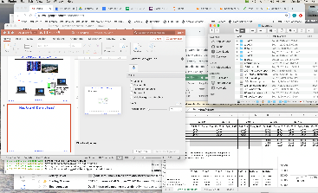
Very Different Situation Today
Powerful system
Huge memory
Huge disk
Single user

Slide 49
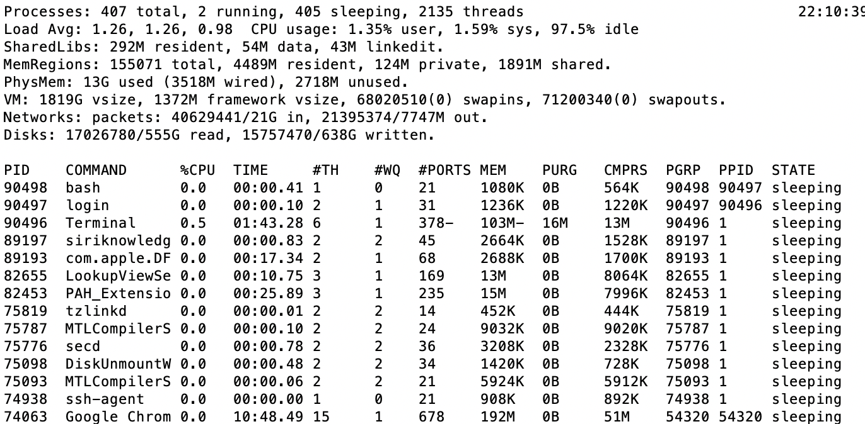
A Picture on one machine
Memory stays about 75% used, 25% for dynamics
A lot of it is shared 1.9 GB

Slide 50
Many Uses of ”Demand Paging” …
Extend the stack
Allocate a page and zero it
Extend the heap (sbrk of old, today mmap)
Process Fork
Create a copy of the page table
Entries refer to parent pages – NO-WRITE
Shared read-only pages remain shared
Copy page on write
Exec
Only bring in parts of the binary in active use
Do this on demand
MMAP to explicitly share region (or to access a file as RAM)

Slide 51
Classic: Loading an executable into memory
disk (huge)
memory
info
data
code
exe
.exe
lives on disk in the file system
contains contents of code & data segments, relocation entries and symbols
OS loads it into memory, initializes registers (and initial stack pointer)
program sets up stack and heap upon initialization: crt0 (C runtime init)

Slide 52
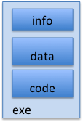
Create Virtual Address Space of the Process
disk (huge)
process VAS
memory
kernel
user page
frames
stack
sbrk
user pagetable
heap
data
kernel code & data
code
Utilized pages in the VAS are backed by a page block on disk
Called the backing store or swap file
Typically in an optimized block store, but can think of it like a file

Slide 53
Create Virtual Address Space of the Process
disk (huge, TB)
process VAS (GBs)
memory
kernel
stack
user page
frames
stack
heap
heap
user pagetable
data
data
code
kernel code & data
code
User Page table maps entire VAS
All the utilized regions are backed on disk
swapped into and out of memory as needed
For every process

Slide 54
Create Virtual Address Space of the Process
disk (huge, TB)
VAS – per process
PT
memory
kernel
stack
user page
frames
stack
heap
heap
user pagetable
data
data
code
kernel code & data
code
User Page table maps entire VAS
Resident pages to the frame in memory they occupy
The portion of it that the HW needs to access must be resident in memory

Slide 55
Provide Backing Store for VAS
disk (huge, TB)
VAS – per process
memory
kernel
stack
user page
frames
stack
heap
heap
user pagetable
data
data
code
kernel code & data
code
User Page table maps entire VAS
Resident pages mapped to memory frames
For all other pages, OS must record where to find them on disk

Slide 56
What Data Structure Maps Non-Resident Pages to Disk?
FindBlock(PID, page#) → disk_block
Some OSs utilize spare space in PTE for paged blocks
Like the PT, but purely software
Where to store it?
In memory – can be compact representation if swap storage is contiguous on disk
Could use hash table (like Inverted PT)
Usually want backing store for resident pages too
May map code segment directly to on-disk image
Saves a copy of code to swap file
May share code segment with multiple instances of the program

Slide 57
Provide Backing Store for VAS
disk (huge, TB)
VAS 1
PT 1
memory
kernel
stack
stack
stack
heap
user page
frames
heap
heap
data
VAS 2
PT 2
data
code
user pagetable
data
kernel
code
stack
kernel code & data
heap
data
code

Slide 58
On page Fault …
disk (huge, TB)
VAS 1
PT 1
memory
kernel
stack
stack
stack
heap
user page
frames
heap
heap
data
VAS 2
PT 2
data
code
user pagetable
data
kernel
code
stack
kernel code
& data
heap
data
active process & PT
code

Slide 59
On page Fault … find & start load
disk (huge, TB)
VAS 1
PT 1
memory
kernel
stack
stack
stack
heap
user page
frames
heap
heap
data
VAS 2
PT 2
data
code
user pagetable
data
kernel
code
stack
kernel code & data
heap
data
active process & PT
code

Slide 60
On page Fault … schedule other P or T
disk (huge, TB)
VAS 1
PT 1
memory
kernel
stack
stack
stack
heap
user page
frames
heap
heap
data
VAS 2
PT 2
data
code
user pagetable
data
kernel
code
stack
kernel code & data
heap
data
active process & PT
code

Slide 61
On page Fault … update PTE
disk (huge, TB)
VAS 1
PT 1
memory
kernel
stack
stack
stack
heap
user page
frames
heap
heap
data
VAS 2
PT 2
data
code
user pagetable
data
kernel
code
stack
kernel code & data
heap
data
active process & PT
code

Slide 62
Eventually reschedule faulting thread
disk (huge, TB)
VAS 1
PT 1
memory
kernel
stack
stack
stack
heap
user page
frames
heap
heap
data
VAS 2
PT 2
data
code
user pagetable
data
kernel
code
stack
kernel code & data
heap
data
active process & PT
code

Slide 63
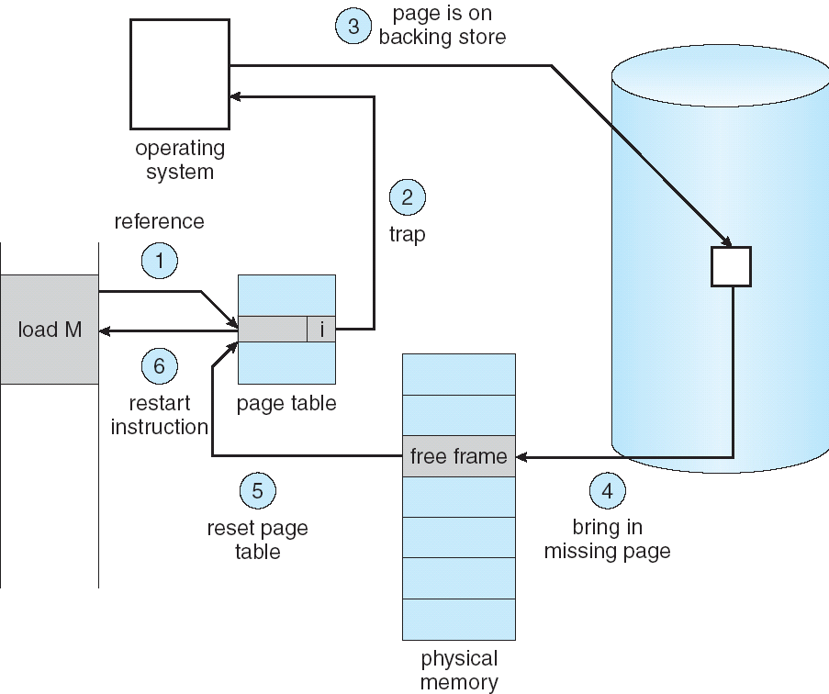
Summary: Steps in Handling a Page Fault

Slide 64
Demand Paging Mechanisms
PTE makes demand paging implementatable
Valid ⇒ Page in memory, PTE points at physical page
Not Valid ⇒ Page not in memory; use info in PTE to find it on disk when necessary
Suppose user references page with invalid PTE?
Memory Management Unit (MMU) traps to OS
Resulting trap is a “Page Fault”
What does OS do on a Page Fault?:
Choose an old page to replace
If old page modified (“D=1”), write contents back to disk
Change its PTE and any cached TLB to be invalid
Load new page into memory from disk
Update page table entry, invalidate TLB for new entry
Continue thread from original faulting location
TLB for new page will be loaded when thread continued!
While pulling pages off disk for one process, OS runs another process from ready queue
Suspended process sits on wait queue
Cache

Slide 65
Some questions we need to answer!
During a page fault, where does the OS get a free frame?
Keeps a free list
Unix runs a “reaper” if memory gets too full
Schedule dirty pages to be written back on disk
Zero (clean) pages which haven’t been accessed in a while
As a last resort, evict a dirty page first
How can we organize these mechanisms?
Work on the replacement policy
How many page frames/process?
Like thread scheduling, need to “schedule” memory resources:
Utilization? fairness? priority?
Allocation of disk paging bandwidth

Slide 66
Cache Behavior under WS model
1
new working set fits
Hit Rate
0
Cache Size
Amortized by fraction of time the Working Set is active
Transitions from one WS to the next
Capacity, Conflict, Compulsory misses
Applicable to memory caches and pages. Others ?

Slide 67
Another model of Locality: Zipf
Likelihood of accessing item of rank r is α 1/rª
Although rare to access items below the top few, there are so many that it yields a “heavy tailed” distribution
Substantial value from even a tiny cache
Substantial misses from even a very large cache

Slide 68
Demand Paging Cost Model
Since Demand Paging like caching, can compute average access time! (“Effective Access Time”)
EAT = Hit Rate x Hit Time + Miss Rate x Miss Time
EAT = Hit Time + Miss Rate x Miss Penalty
Example:
Memory access time = 200 nanoseconds
Average page-fault service time = 8 milliseconds
Suppose p = Probability of miss, 1-p = Probably of hit
Then, we can compute EAT as follows:
EAT = 200ns + p x 8 ms
= 200ns + p x 8,000,000ns
If one access out of 1,000 causes a page fault, then EAT = 8.2 μs:
This is a slowdown by a factor of 40!
What if want slowdown by less than 10%?
200ns x 1.1 < EAT ⇒ p < 2.5 x 10⁻⁶
This is about 1 page fault in 400,000!

Slide 69
What Factors Lead to Misses in Page Cache?
Compulsory Misses:
Pages that have never been paged into memory before
How might we remove these misses?
Prefetching: loading them into memory before needed
Need to predict future somehow! More later
Capacity Misses:
Not enough memory. Must somehow increase available memory size.
Can we do this?
One option: Increase amount of DRAM (not quick fix!)
Another option: If multiple processes in memory: adjust percentage of memory allocated to each one!
Conflict Misses:
Technically, conflict misses don’t exist in virtual memory, since it is a “fully-associative” cache
Policy Misses:
Caused when pages were in memory, but kicked out prematurely because of the replacement policy
How to fix? Better replacement policy

Slide 70
Page Replacement Policies
Why do we care about Replacement Policy?
Replacement is an issue with any cache
Particularly important with pages
The cost of being wrong is high: must go to disk
Must keep important pages in memory, not toss them out
FIFO (First In, First Out)
Throw out oldest page. Be fair – let every page live in memory for same amount of time.
Bad – throws out heavily used pages instead of infrequently used
RANDOM:
Pick random page for every replacement
Typical solution for TLB’s. Simple hardware
Pretty unpredictable – makes it hard to make real-time guarantees
MIN (Minimum):
Replace page that won’t be used for the longest time
Great (provably optimal), but can’t really know future…
But past is a good predictor of the future …

Slide 71
Replacement Policies (Con’t)
LRU (Least Recently Used):
Replace page that hasn’t been used for the longest time
Programs have locality, so if something not used for a while, unlikely to be used in the near future.
Seems like LRU should be a good approximation to MIN.
How to implement LRU? Use a list!
On each use, remove page from list and place at head
LRU page is at tail
Problems with this scheme for paging?
Need to know immediately when each page used so that can change position in list…
Many instructions for each hardware access
In practice, people approximate LRU (more later)
Page 6
Page 7
Page 1
Page 2
Head
Tail (LRU)

Slide 72
Example: FIFO (strawman)
Suppose we have 3 page frames, 4 virtual pages, and following reference stream:
A B C A B D A D B C B
Consider FIFO Page replacement:
FIFO: 7 faults
When referencing D, replacing A is bad choice, since need A again right away
Ref:
Page:
A
B
C
A
B
D
A
D
B
C
B
1
A
D
C
2
B
A
3
C
B

Slide 73
Example: MIN / LRU
Suppose we have the same reference stream:
A B C A B D A D B C B
Consider MIN Page replacement:
MIN: 5 faults
Where will D be brought in? Look for page not referenced farthest in future
What will LRU do?
Same decisions as MIN here, but won’t always be true!
Ref:
Page:
A
B
C
A
B
D
A
D
B
C
B
1
A
C
2
B
3
C
D

Slide 74
Is LRU guaranteed to perform well?
Consider the following: A B C D A B C D A B C D
LRU Performs as follows (same as FIFO here):
Every reference is a page fault!
Fairly contrived example of working set of N+1 on N frames
Ref:
Page:
A
B
C
D
A
B
C
D
A
B
C
D
1
A
D
C
B
2
B
A
D
C
3
C
B
A
D

Slide 75
When will LRU perform badly?
Consider the following: A B C D A B C D A B C D
LRU Performs as follows (same as FIFO here):
Every reference is a page fault!
MIN Does much better:
Ref:
Page:
A
B
C
D
A
B
C
D
A
B
C
D
1
A
D
C
B
2
B
A
D
C
3
C
B
A
D
Ref:
Page:
A
B
C
D
A
B
C
D
A
B
C
D
1
A
B
2
B
C
3
C
D

Slide 76
Why it works in Practice: Working Set Model
As a program executes it transitions through a sequence of “working sets” consisting of varying sized subsets of the address space
Address
Time

Slide 77
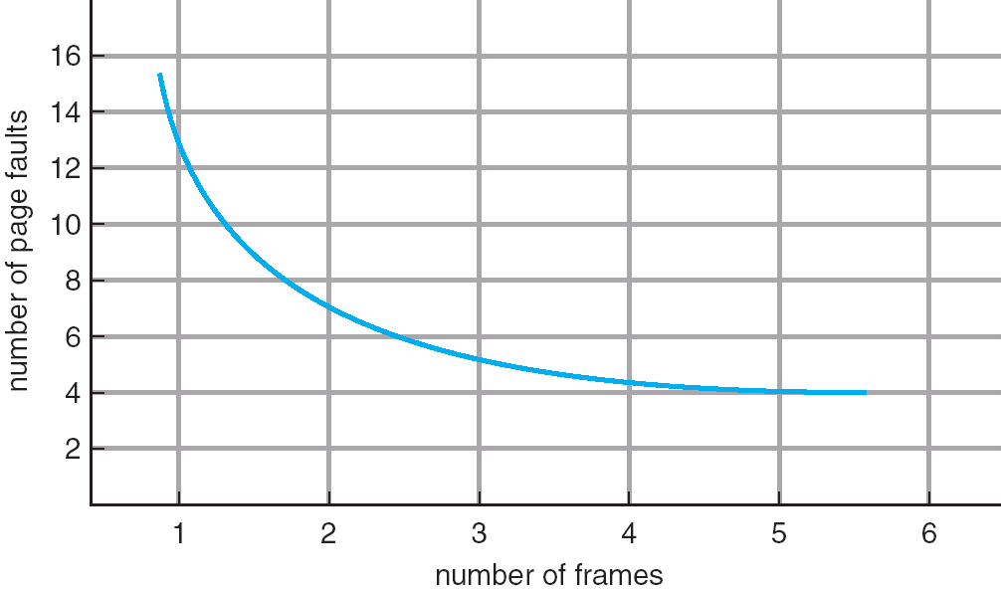
Graph of Page Faults Versus The Number of Frames
One desirable property: When you add memory the miss rate drops (stack property)
Does this always happen?
Seems like it should, right?
No: Bélády’s anomaly
Certain replacement algorithms (FIFO) don’t have this obvious property!

Slide 78
Adding Memory Doesn’t Always Help Fault Rate
Does adding memory reduce number of page faults?
Yes for LRU and MIN
Not necessarily for FIFO! (Called Bélády’s anomaly)
After adding memory:
With FIFO, contents can be completely different
In contrast, with LRU or MIN, contents of memory with X pages are a subset of contents with X+1 Page
Ref:
Page:
A
B
C
D
A
B
E
A
B
C
D
E
1
A
D
E
2
B
A
C
3
C
B
D
Ref:
Page:
A
B
C
D
A
B
E
A
B
C
D
E
1
A
E
D
2
B
A
E
3
C
B
4
D
C

Slide 79
Summary (1/2)
The Principle of Locality:
Program likely to access a relatively small portion of the address space at any instant of time.
Temporal Locality: Locality in Time
Spatial Locality: Locality in Space
Three (+1) Major Categories of Cache Misses:
Compulsory Misses: sad facts of life. Example: cold start misses.
Conflict Misses: increase cache size and/or associativity
Capacity Misses: increase cache size
Coherence Misses: Caused by external processors or I/O devices
Cache Organizations:
Direct Mapped: single block per set
Set associative: more than one block per set
Fully associative: all entries equivalent
Notes:
Let’s summarize today’s lecture. I know you have heard this many times and many ways but it is still worth repeating.
Memory hierarchy works because of the Principle of Locality which says a program will access a relatively small portion of the address space at any instant of time.
There are two types of locality: temporal locality, or locality in time and spatial locality, or locality in space.
So far, we have covered three major categories of cache misses.
Compulsory misses are cache misses due to cold start. You cannot avoid them but if you are going to run billions of instructions anyway, compulsory misses usually don’t bother you.
Conflict misses are misses caused by multiple memory location being mapped to the same cache location.
The nightmare scenario is the ping pong effect when a block is read into the cache but before we have a chance to use it, it was immediately forced out by another conflict miss.
You can reduce Conflict misses by either increase the cache size or increase the associativity, or both.
Finally, Capacity misses occurs when the cache is not big enough to contains all the cache blocks required by the program. You can reduce this miss rate by making the cache larger.
There are two write policy as far as cache write is concerned. Write through requires a write buffer and a nightmare scenario is when the store occurs so frequent that you saturates your write buffer.
The second write polity is write back. In this case, you only write to the cache and only when the cache block is being replaced do you write the cache block back to memory.
+3 = 77 min. (Y:57)

Slide 80
Summary (2/2)
“Translation Lookaside Buffer” (TLB)
Small number of PTEs and optional process IDs (< 512)
Fully Associative (Since conflict misses expensive)
On TLB miss, page table must be traversed and if located PTE is invalid, cause Page Fault
On change in page table, TLB entries must be invalidated
TLB is logically in front of cache (need to overlap with cache access)
Precise Exception specifies a single instruction for which:
All previous instructions have completed (committed state)
No following instructions nor actual instruction have started
Can manage caches in hardware or software or both
Goal is highest hit rate, even if it means more complex cache management
Notes:
No fancy replacement policy is needed for the direct mapped cache.
As a matter of fact, that is what cause direct mapped trouble to begin with: only one place to go in the cache--causes conflict misses.
No fancy replacement policy is needed for the direct mapped cache.
As a matter of fact, that is what cause direct mapped trouble to begin with: only one place to go in the cache--causes conflict misses.
Besides working at Sun, I also teach people how to fly whenever I have time.
Statistic have shown that if a pilot crashed after an engine failure, he or she is more likely to get killed in a multi-engine light airplane than a single engine airplane.
The joke among us flight instructors is that: sure, when the engine quit in a single engine stops, you have one option: sooner or later, you land. Probably sooner.
But in a multi-engine airplane with one engine stops, you have a lot of options. It is the need to make a decision that kills those people.

